Slide 1

18ECC205J- ANALOG AND DIGITAL COMMUNICATION
UNIT-1
S-7 Frequency modulation, Types of FM-Narrow Band FM, Wide Band FM, Phase modulation
S-8 Generation of Narrowband FM
S-9 Demodulation of FM : Foster seely discriminator

Slide 2
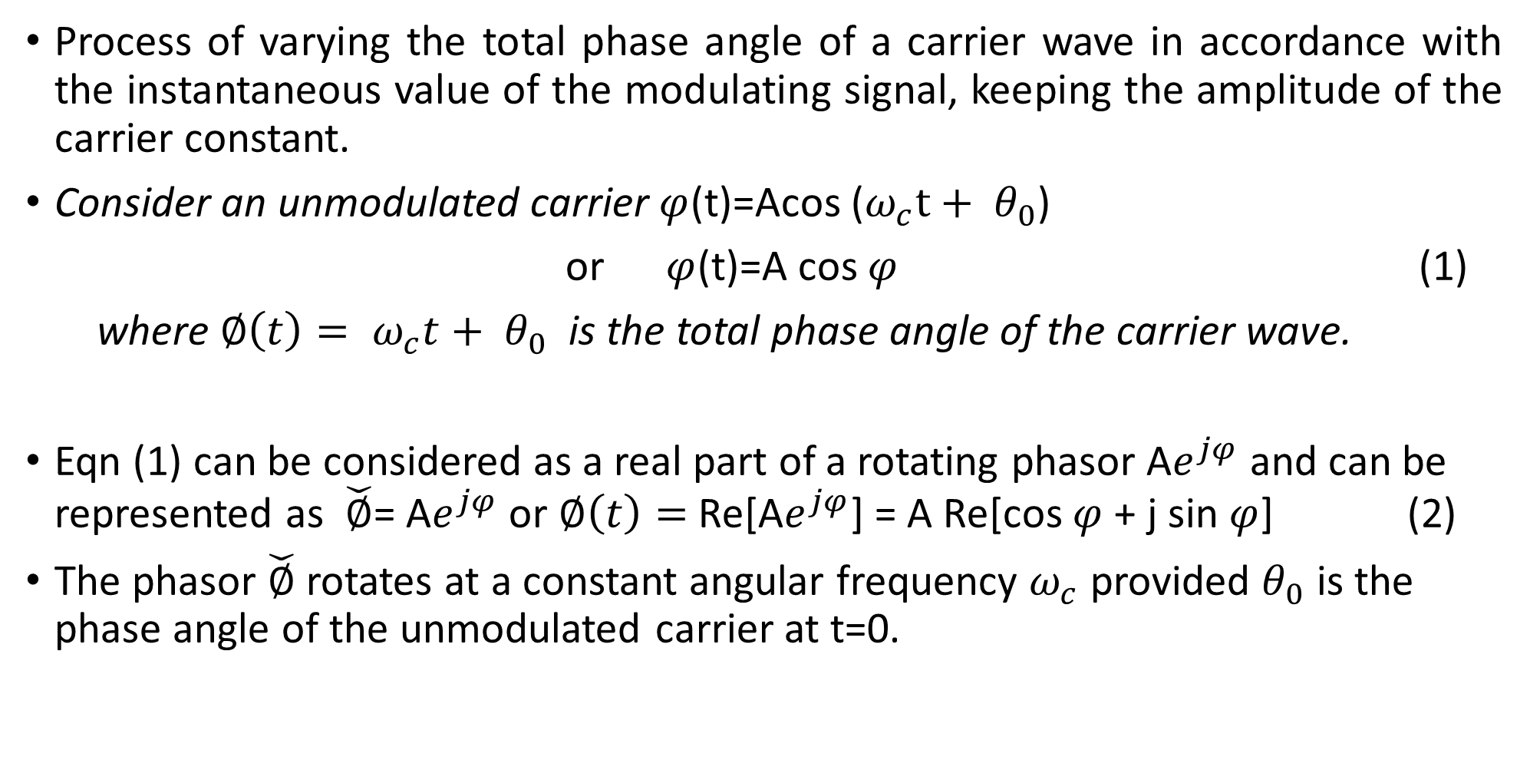
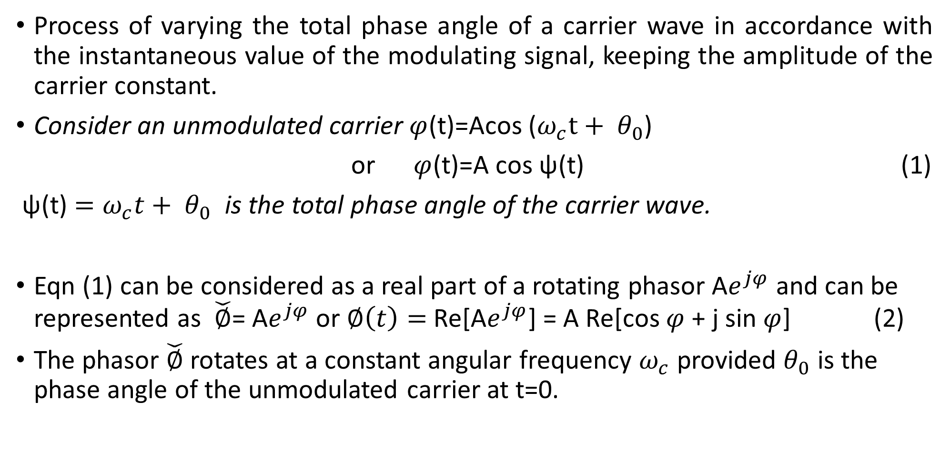
Angle modulation
Process of varying the total phase angle of a carrier wave in accordance with the instantaneous value of the modulating signal, keeping the amplitude of the carrier constant.
Consider an unmodulated carrier $φ$(t)=Acos ($ω_{c}t+ θ_{0}$)
or $φ$(t)=A cos ψ(t) (1)
ψ(t) $=ω_{c}t+ θ_{0}$ is the total phase angle of the carrier wave.
Eqn (1) can be considered as a real part of a rotating phasor A$e^{jφ}$ and can be represented as $\check{∅}$= A$e^{jφ}$ or $∅\left(t\right)=$ Re[A$e^{jφ}$] = A Re[cos $φ$ + j sin $φ$] (2)
The phasor $\check{∅}$ rotates at a constant angular frequency $ω_{c}$ provided $θ_{0}$ is the phase angle of the unmodulated carrier at t=0.

Slide 3
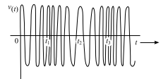
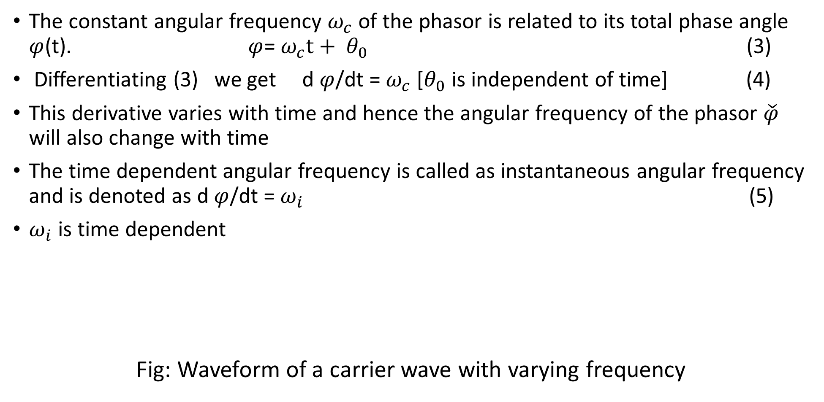
Instantaneous frequency
The constant angular frequency $ω_{c}$ of the phasor is related to its total phase angle $φ$(t). $φ$= $ω_{c}t+ θ_{0}$ (3)
Differentiating (3) we get d $φ$/dt = $ω_{c}$ [$θ_{0}$ is independent of time] (4)
This derivative varies with time and hence the angular frequency of the phasor $\check{φ}$ will also change with time
The time dependent angular frequency is called as instantaneous angular frequency and is denoted as d $φ$/dt = $ω_{i}$ (5)
$ω_{i}$ is time dependent
Fig: Waveform of a carrier wave with varying frequency

Slide 4
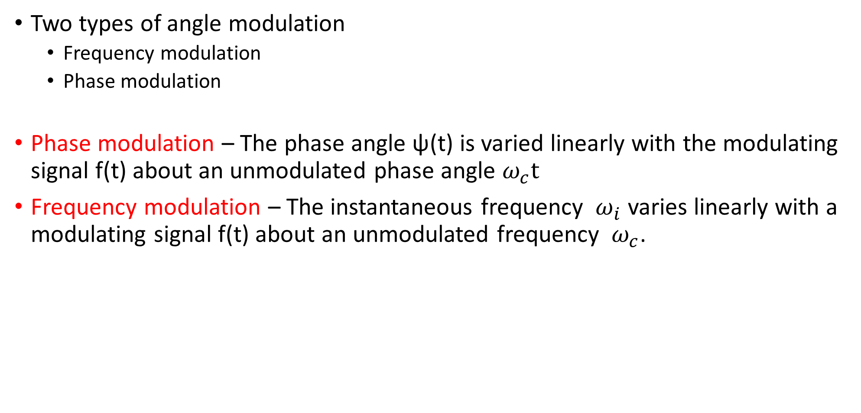
Types of Angle modulation
Two types of angle modulation
Frequency modulation
Phase modulation
Phase modulation – The phase angle ψ(t) is varied linearly with the modulating signal f(t) about an unmodulated phase angle $ω_{c}t$
Frequency modulation – The instantaneous frequency $ω_{i}$ varies linearly with a modulating signal f(t) about an unmodulated frequency $ω_{c}$.

Slide 5
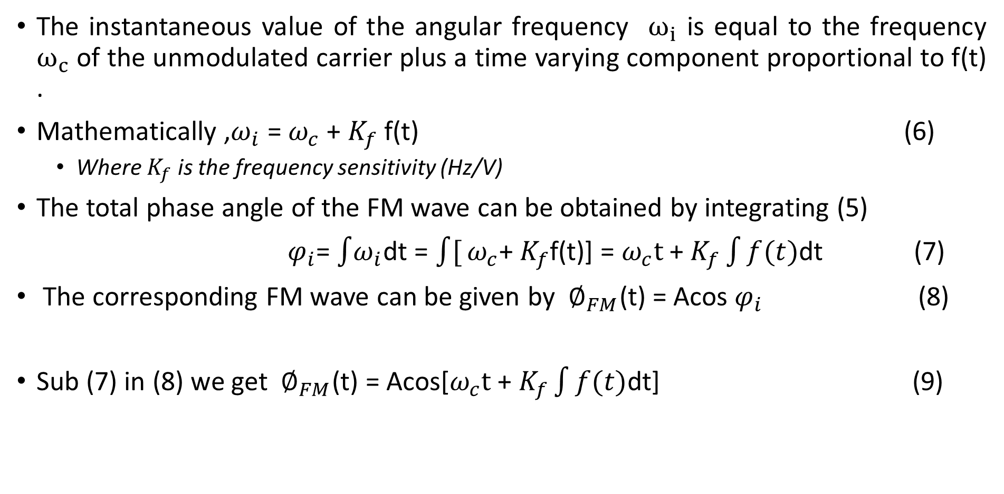
Representation of Frequency modulated signal
The instantaneous value of the angular frequency $ω_{i}$ is equal to the frequency $ω_{c}$ of the unmodulated carrier plus a time varying component proportional to f(t) .
Mathematically ,$ω_{i}$ = $ω_{c}$ + $K_{f}$ f(t) (6)
Where $K_{f}$ is the frequency sensitivity (Hz/V)
The total phase angle of the FM wave can be obtained by integrating (5)
$φ_{i}$= $\int{ω_{i}}$dt = $\int{[}ω_{c}$+ $K_{f}$f(t)] = $ω_{c}t$ + $K_{f}\int{f(t)}$dt (7)
The corresponding FM wave can be given by $∅_{FM}$(t) = Acos $φ_{i}$ (8)
Sub (7) in (8) we get ${ ∅}_{FM}$(t) = Acos[$ω_{c}t$ + $K_{f}\int{f(t)}$dt] (9)

Slide 6
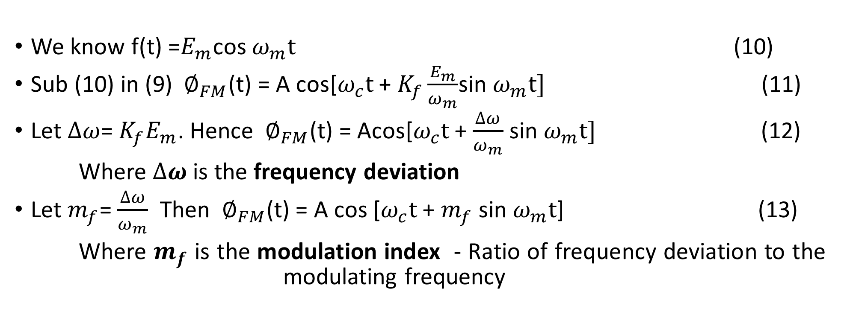
Representation of Frequency modulated signal- Contd
We know f(t) =$E_{m}$cos $ω_{m}t$ (10)
Sub (10) in (9) ${ ∅}_{FM}$(t) = A cos[$ω_{c}t$ + $K_{f}\frac{E_{m}}{ω_{m}}$sin $ω_{m}t]$ (11)
Let $∆ω$= $K_{f}E_{m}$. Hence ${ ∅}_{FM}$(t) = Acos[$ω_{c}t$ + $\frac{∆ω}{ω_{m}}$ sin $ω_{m}t]$ (12)
Where $∆ω$ is the frequency deviation
Let $m_{f}$= $\frac{∆ω}{ω_{m}}$ Then ${ ∅}_{FM}$(t) = A cos [$ω_{c}t$ + $m_{f}$ sin $ω_{m}t$] (13)
Where $m_{f}$ is the modulation index - Ratio of frequency deviation to the modulating frequency

Slide 7
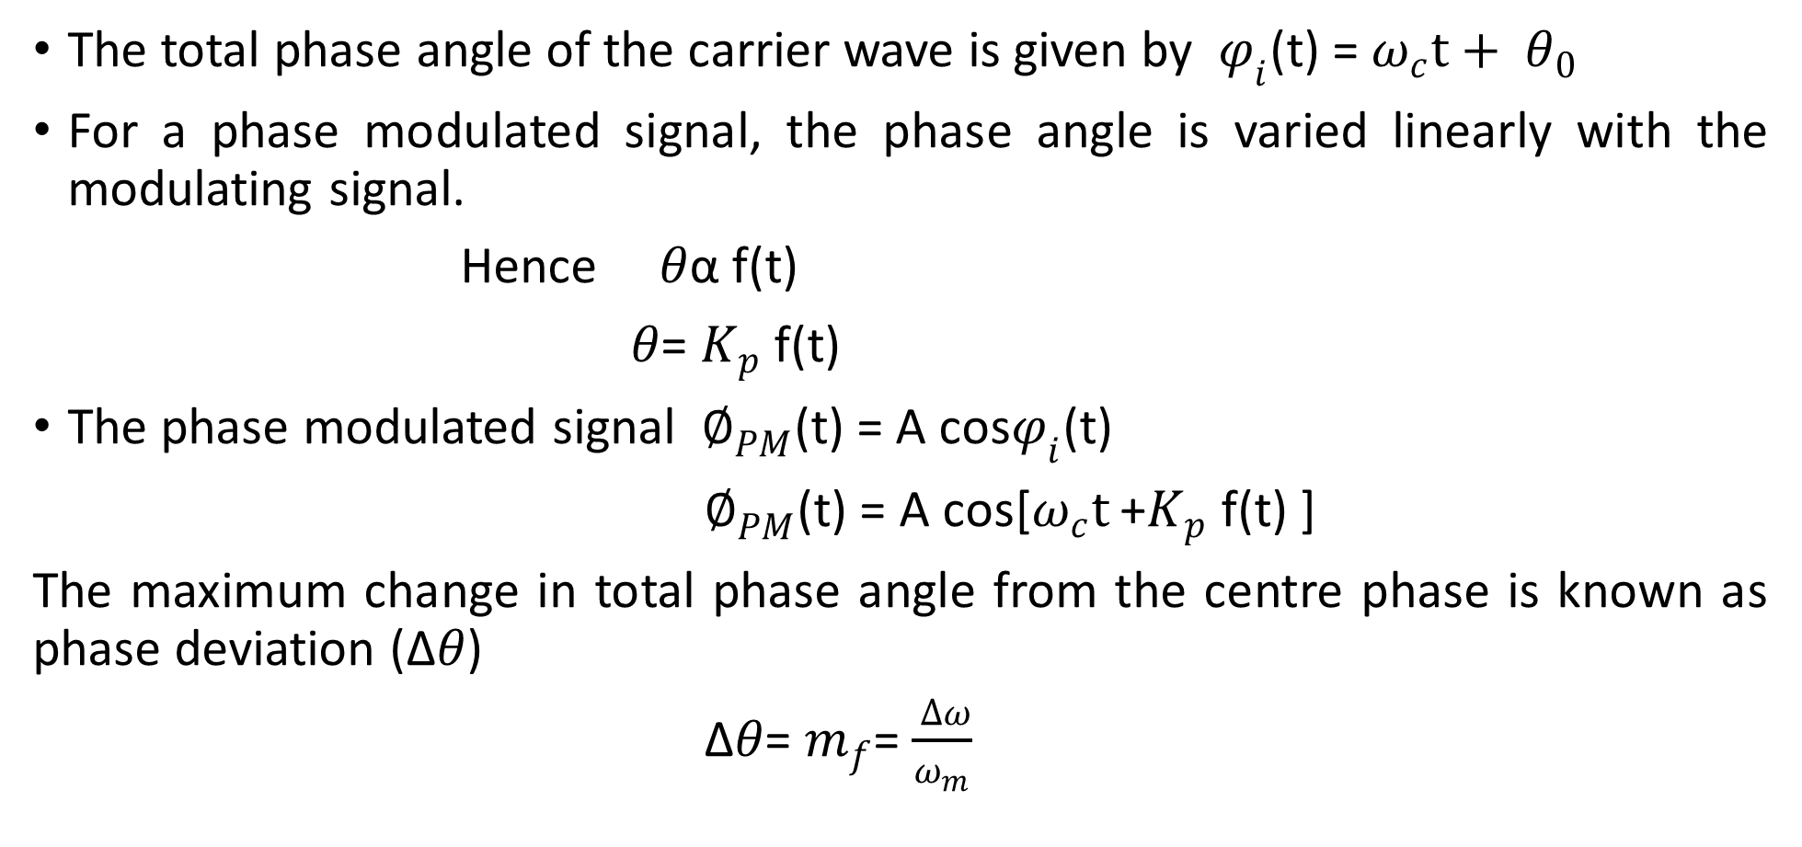
Representation of Phase modulated signal
The total phase angle of the carrier wave is given by $φ_{i}$(t) = $ω_{c}t+ θ_{0}$
For a phase modulated signal, the phase angle is varied linearly with the modulating signal.
Hence $θ$α f(t)
$θ$= $K_{p}$ f(t)
The phase modulated signal ${ ∅}_{PM}$(t) = A cos$φ_{i}$(t)
${ ∅}_{PM}$(t) = A cos[$ω_{c}t$ +$K_{p}$ f(t) ]
The maximum change in total phase angle from the centre phase is known as phase deviation (∆$θ$)
∆$θ$= $m_{f}$= $\frac{ ∆ω}{ω_{m}}$

Slide 8
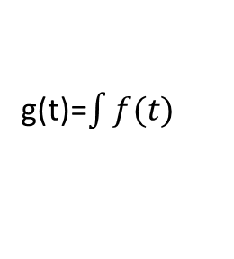



Relationship between PM and FM
FM generation using Phase modulator
PM generation using Frequency modulator
g(t)=$\int{f(t)}$
g(t)=$\frac{d f(t)}{dt}$
Integrator
Phase modulator
Differentiator
Frequency modulator
f(t)
FM
f(t)
PM
Acos $ω_{c}t$
Acos $ω_{c}t$
Carrier generator
Carrier generator

Slide 9
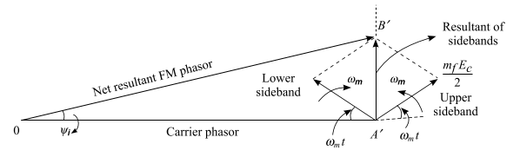
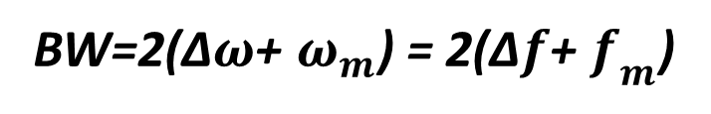


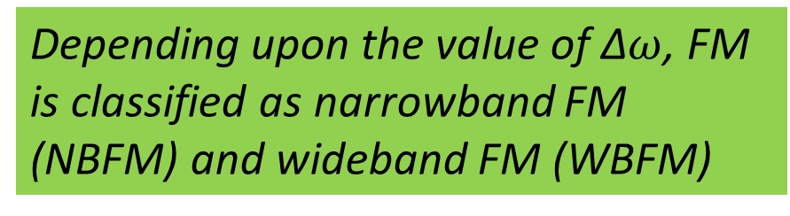
Transmission bandwidth of FM signal
Bandwidth=2n$ω_{m}$
where n is the number of sidebands
n≈$m_{f}$
BW=2$m_{f}ω_{m}$=2∆$ω$=2∆f
Bandwidth using Carson’s rule
Bandwidth of PM signal
BW(PM) ≈ 2∆$ω$
= 2$K_{p}E_{m}ω_{m}$
Modulation index of PM signal
$m_{p}$= $K_{p}E_{m}$= $θ_{d}$
BW=2(∆$ω$+ $ω_{m}$) = 2(∆$f$+ $f_{m}$)
Depending upon the value of ∆$ω$, FM is classified as narrowband FM (NBFM) and wideband FM (WBFM)
Figure: Phasor diagram of FM

Slide 10
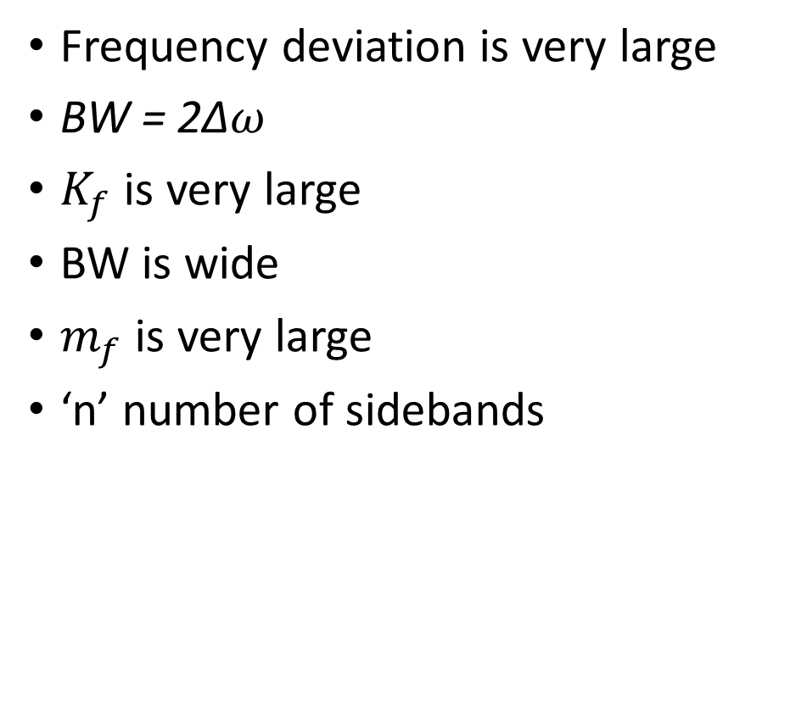
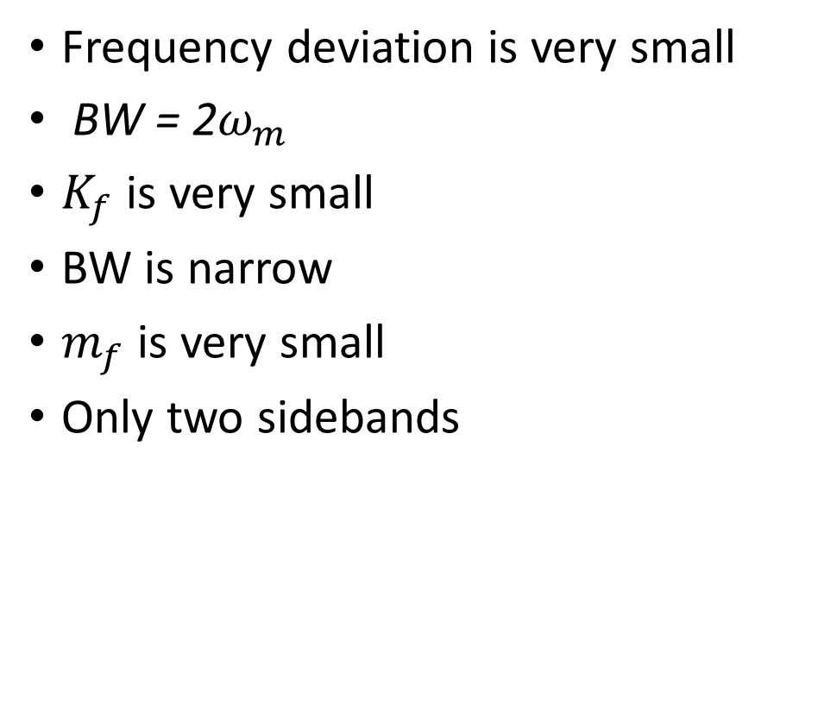
Comparison between NBFM and WBFM
NBFM
WBFM
Frequency deviation is very small
BW = 2$ω_{m}$
$K_{f}$ is very small
BW is narrow
$m_{f}$ is very small
Only two sidebands
Frequency deviation is very large
BW = 2$\text{∆}ω$
$K_{f}$ is very large
BW is wide
$m_{f}$ is very large
‘n’ number of sidebands

Slide 11
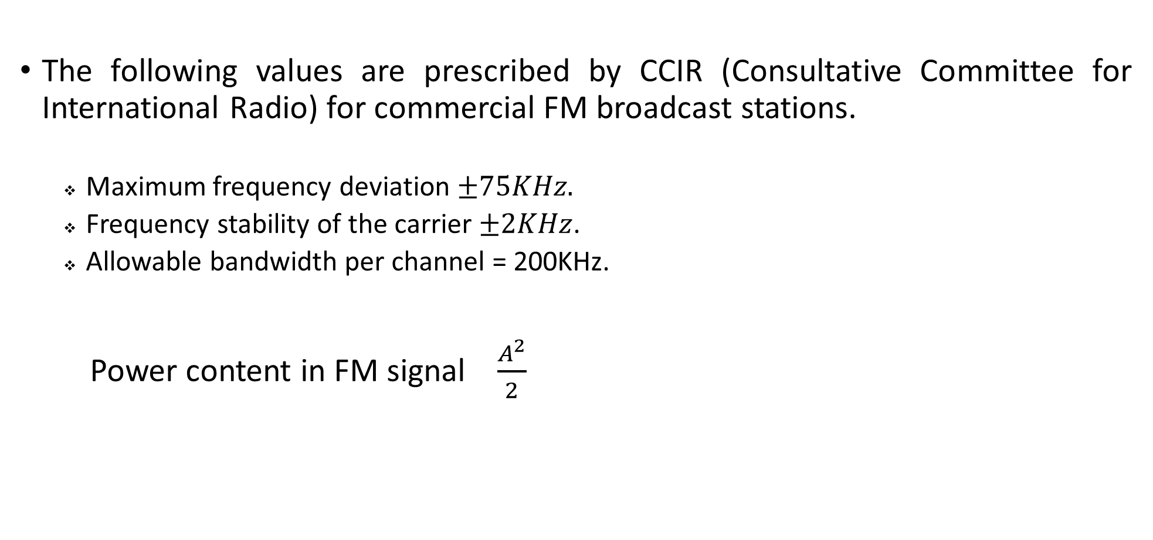
International regulation for FM signal
The following values are prescribed by CCIR (Consultative Committee for International Radio) for commercial FM broadcast stations.
Maximum frequency deviation $±75KHz.$
Frequency stability of the carrier $±2KHz$.
Allowable bandwidth per channel = 200KHz.
Power content in FM signal $\frac{A^{2}}{2}$

Slide 12
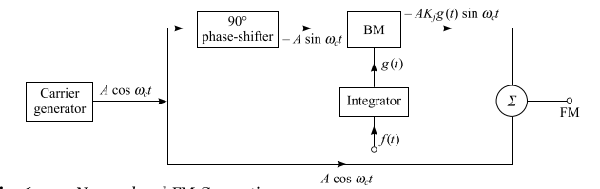
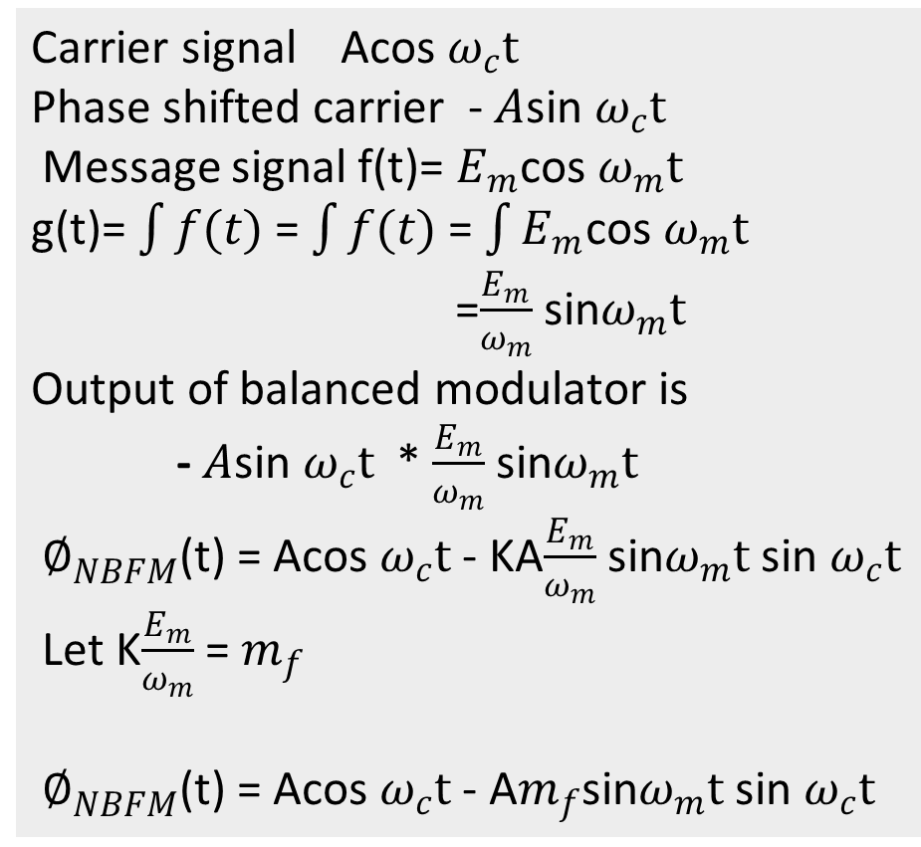
Generation of Narrowband FM
Carrier signal Acos $ω_{c}t$
Phase shifted carrier - $A$sin $ω_{c}t$
Message signal f(t)= $E_{m}$cos $ω_{m}t$
g(t)= $\int{f(t)}$ = $\int{f(t)}$ = $\int{E_{m}}$cos $ω_{m}t$
=$\frac{E_{m}}{ω_{m}}$ sin$ω_{m}t$
Output of balanced modulator is
- $A$sin $ω_{c}t$ * $\frac{E_{m}}{ω_{m}}$ sin$ω_{m}t$
${ ∅}_{NBFM}$(t) = Acos $ω_{c}t$ - KA$\frac{E_{m}}{ω_{m}}$ sin$ω_{m}t$ sin $ω_{c}t$
Let K$\frac{E_{m}}{ω_{m}}$ = $m_{f}$
${ ∅}_{NBFM}$(t) = Acos $ω_{c}t$ - A$m_{f}$sin$ω_{m}t$ sin $ω_{c}t$

Slide 13
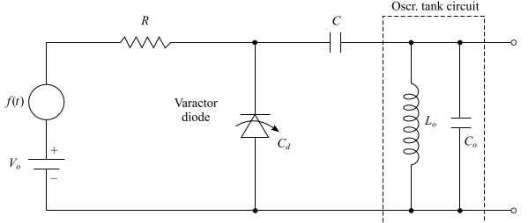
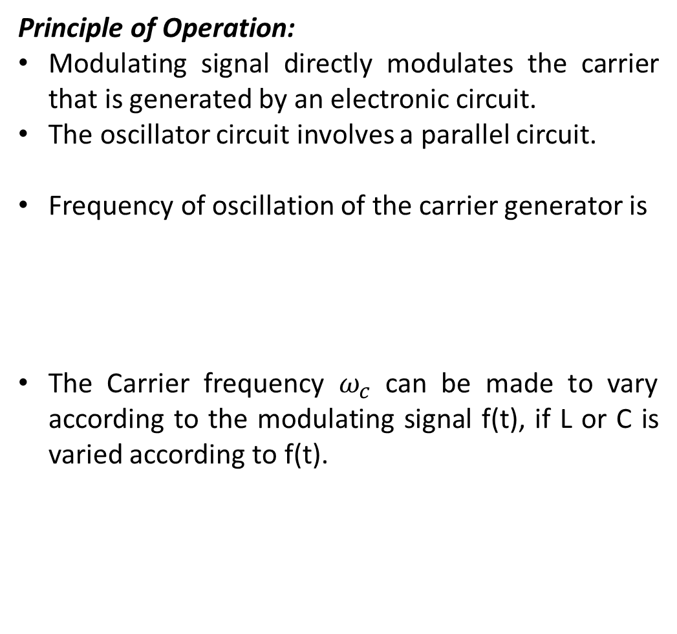

Varactor diode FM modulation
Principle of Operation:
Modulating signal directly modulates the carrier that is generated by an electronic circuit.
The oscillator circuit involves a parallel circuit.
Frequency of oscillation of the carrier generator is
The Carrier frequency $ω_{c}$ can be made to vary according to the modulating signal f(t), if L or C is varied according to f(t).
${ ω}_{c}$= $\frac{1}{\sqrt{LC}}$

Slide 14
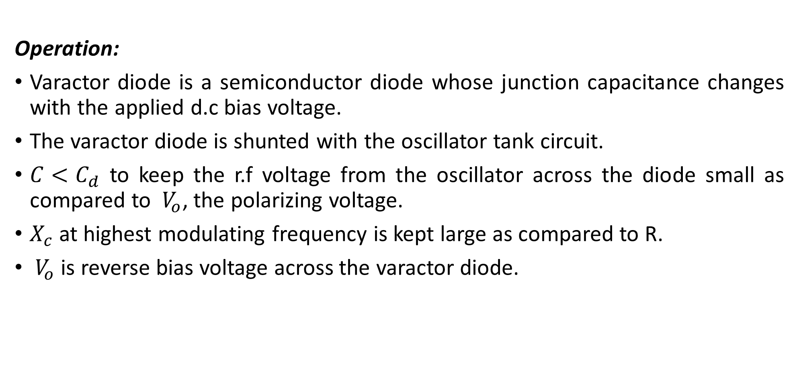
Varactor diode FM modulation Contd..
Operation:
Varactor diode is a semiconductor diode whose junction capacitance changes with the applied d.c bias voltage.
The varactor diode is shunted with the oscillator tank circuit.
$C<C_{d}$ to keep the r.f voltage from the oscillator across the diode small as compared to ${ V}_{o}$, the polarizing voltage.
$X_{c}$ at highest modulating frequency is kept large as compared to R.
${ V}_{o}$ is reverse bias voltage across the varactor diode.

Slide 15
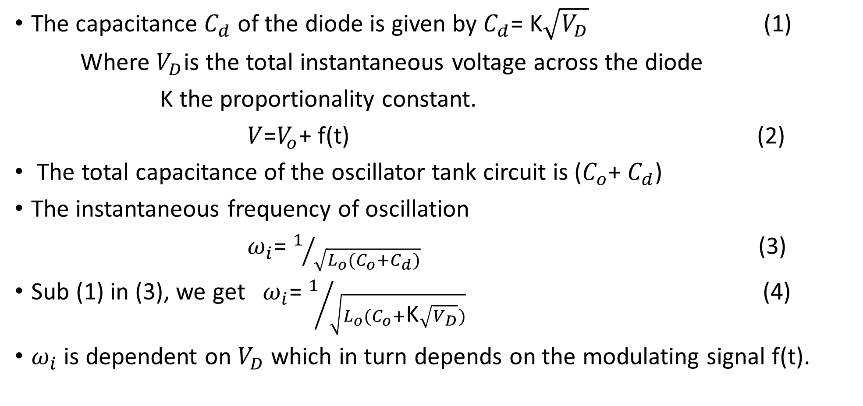
Varactor diode FM modulation Contd..
The capacitance $C_{d}$ of the diode is given by $C_{d}$= K$\sqrt{V_{D}}$ (1)
Where $V_{D}$is the total instantaneous voltage across the diode
K the proportionality constant.
$V$=$V_{o}$+ f(t) (2)
The total capacitance of the oscillator tank circuit is ($C_{o}$+ $C_{d}$)
The instantaneous frequency of oscillation
$ω_{i}$= $1/{\sqrt{L_{o}(C_{o}+C_{d})}}$ (3)
Sub (1) in (3), we get $ω_{i}$= $1/{\sqrt{L_{o}(C_{o}+\text{K}\sqrt{V_{D}})}}$ (4)
$ω_{i}$ is dependent on $V_{D}$ which in turn depends on the modulating signal f(t).

Slide 16
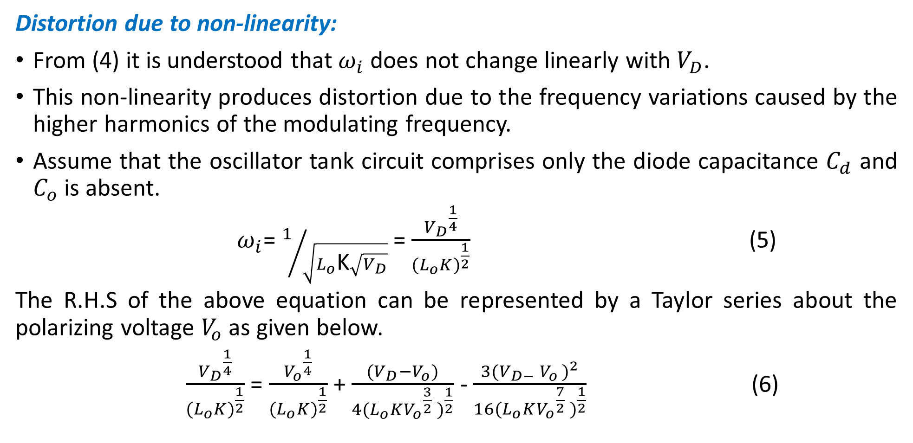
Varactor diode FM modulation Contd..
Distortion due to non-linearity:
From (4) it is understood that $ω_{i}$ does not change linearly with $V_{D}$.
This non-linearity produces distortion due to the frequency variations caused by the higher harmonics of the modulating frequency.
Assume that the oscillator tank circuit comprises only the diode capacitance $C_{d}$ and $C_{o}$ is absent.
$ω_{i}$= $1/{\sqrt{L_{o}\text{K}\sqrt{V_{D}}}}$ = $\frac{{V_{D}}^{\frac{1}{4}}}{{{(L}_{o}K)}^{\frac{1}{2}}}$ (5)
The R.H.S of the above equation can be represented by a Taylor series about the polarizing voltage $V_{o}$ as given below.
$\frac{{V_{D}}^{\frac{1}{4}}}{{{(L}_{o}K)}^{\frac{1}{2}}}$ = $\frac{{V_{o}}^{\frac{1}{4}}}{{{(L}_{o}K)}^{\frac{1}{2}}}$ + $\frac{(V_{D}−V_{o})}{{{4(L}_{o}K{V_{o}}^{\frac{3}{2}} )}^{\frac{1}{2}}}$ - $\frac{3({V_{D−} V_{o })}^{2}}{{{16(L}_{o}K{V_{o}}^{\frac{7}{2}} )}^{\frac{1}{2}}}$ (6)

Slide 17
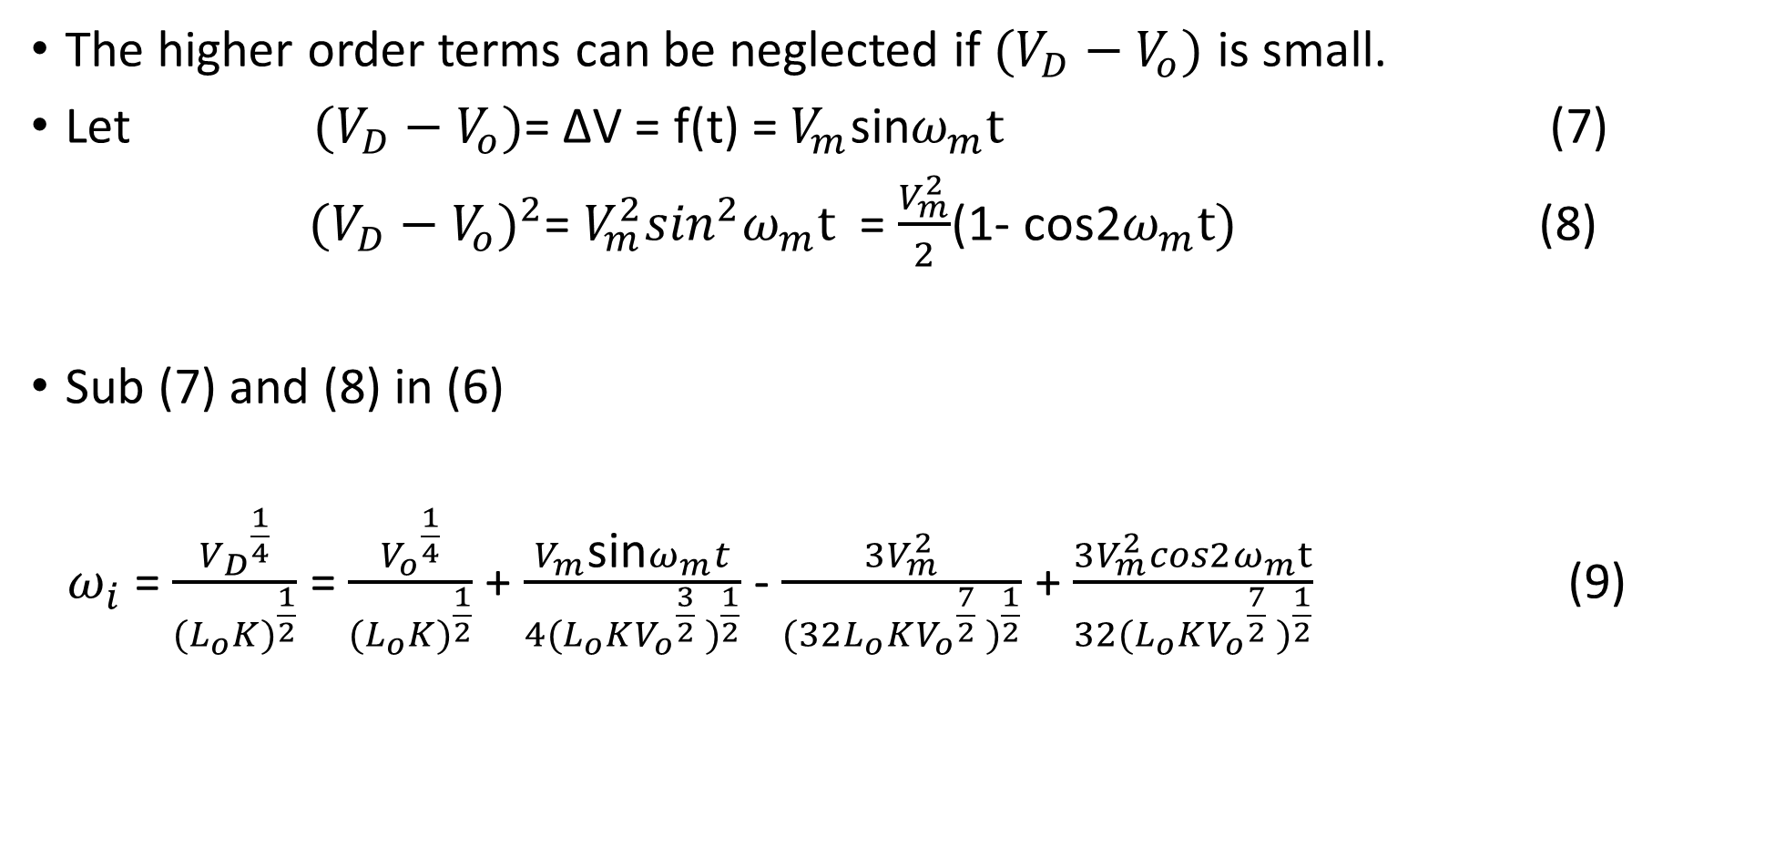
Varactor diode FM modulation Contd..
The higher order terms can be neglected if $(V_{D}−V_{o})$ is small.
Let $(V_{D}−V_{o})$= ∆V = f(t) = $V_{m}$sin$ω_{m}t$ (7)
${(V_{D}−V_{o})}^{2}$= $V_{m}^{2}\sin^{2}ω_{m}t$ = $\frac{V_{m}^{2}}{2}$(1- cos2$ω_{m}t)$ (8)
Sub (7) and (8) in (6)
${ ω}_{i}$ = $\frac{{V_{D}}^{\frac{1}{4}}}{{{(L}_{o}K)}^{\frac{1}{2}}}$ = $\frac{{V_{o}}^{\frac{1}{4}}}{{{(L}_{o}K)}^{\frac{1}{2}}}$ + $\frac{V_{m}\text{sin}ω_{m}t}{{{4(L}_{o}K{V_{o}}^{\frac{3}{2}} )}^{\frac{1}{2}}}$ - $\frac{3V_{m}^{2}}{{{(32L}_{o}K{V_{o}}^{\frac{7}{2}} )}^{\frac{1}{2}}}$ + $\frac{3V_{m}^{2}cos2ω_{m}t}{{{32(L}_{o}K{V_{o}}^{\frac{7}{2}} )}^{\frac{1}{2}}}$ (9)

Slide 18
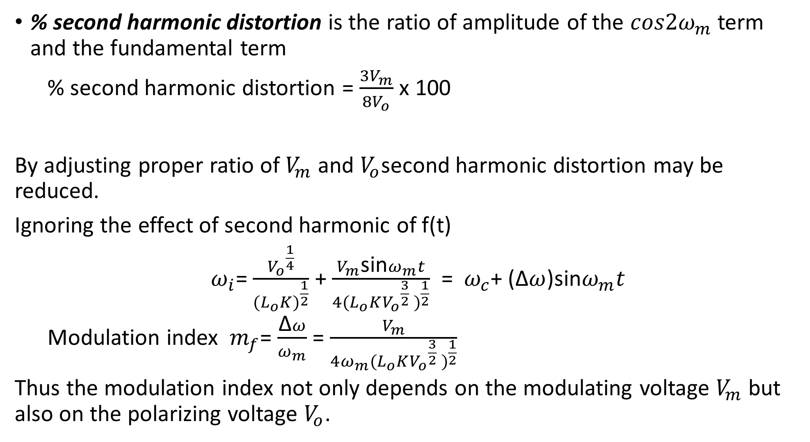
Varactor diode FM modulation Contd..
% second harmonic distortion is the ratio of amplitude of the $cos2ω_{m}$ term and the fundamental term
% second harmonic distortion = $\frac{{3V}_{m}}{{8V}_{o}}$ x 100
By adjusting proper ratio of $V_{m}$ and $V_{o}$second harmonic distortion may be reduced.
Ignoring the effect of second harmonic of f(t)
${ ω}_{i}$= $\frac{{V_{o}}^{\frac{1}{4}}}{{{(L}_{o}K)}^{\frac{1}{2}}}$ + $\frac{V_{m}\text{sin}ω_{m}t}{{{4(L}_{o}K{V_{o}}^{\frac{3}{2}} )}^{\frac{1}{2}}}$ = ${ ω}_{c}$+ (∆$ω$)$\text{sin}ω_{m}t$
Modulation index ${ m}_{f}$= $\frac{\text{∆}ω}{ω_{m}}$ = $\frac{V_{m}}{{{4ω_{m}(L}_{o}K{V_{o}}^{\frac{3}{2}} )}^{\frac{1}{2}}}$
Thus the modulation index not only depends on the modulating voltage $V_{m}$ but also on the polarizing voltage $V_{o}$.

Slide 19
Demodulation of FM signals
The process of recovering the modulating signal from a modulated carrier is known as modulation.
The detector performs the modulation in two steps.
FM signal is converted to its corresponding AM signal using frequency dependent circuits (frequency discriminators)
The original message signal is recovered from this AM signal by using linear diode detector.
Types of FM discriminators
1)Slope detector
Simple slope detector or single-tuned discriminator circuit
Balanced slope detector or stagger tuned discriminator circuit
2)Phase Difference discriminator
Foster-Seeley discriminator
Ratio detector

Slide 20
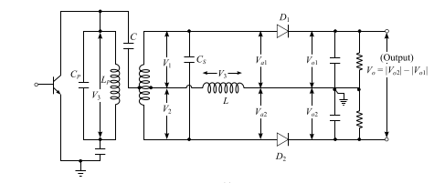
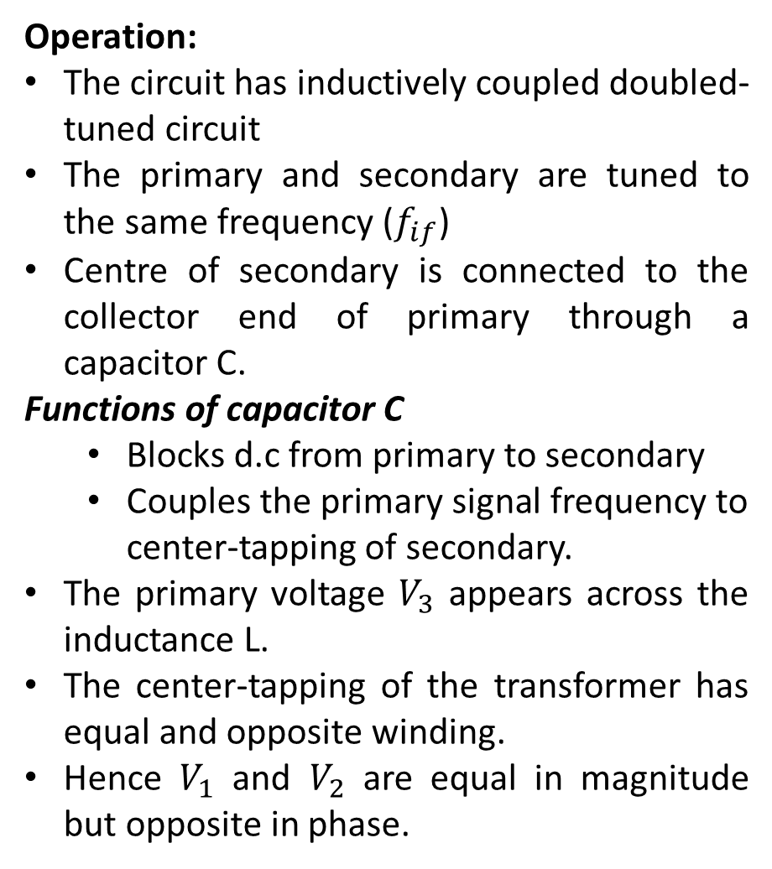
Foster-Seeley discriminator
Operation:
The circuit has inductively coupled doubled- tuned circuit
The primary and secondary are tuned to the same frequency ($f_{if}$)
Centre of secondary is connected to the collector end of primary through a capacitor C.
Functions of capacitor C
Blocks d.c from primary to secondary
Couples the primary signal frequency to center-tapping of secondary.
The primary voltage $V_{3}$ appears across the inductance L.
The center-tapping of the transformer has equal and opposite winding.
Hence $V_{1}$ and $V_{2}$ are equal in magnitude but opposite in phase.

Slide 21
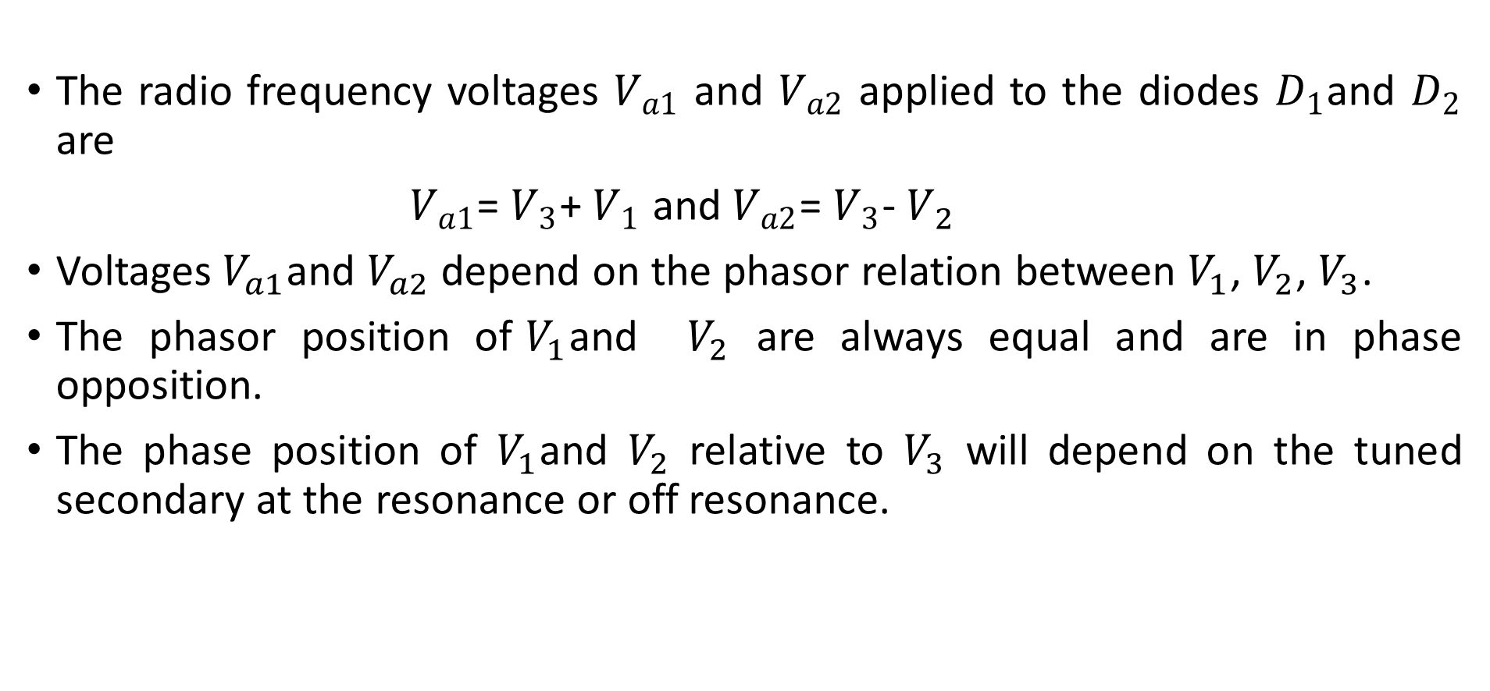
Foster-Seeley discriminator Contd..
The radio frequency voltages $V_{a1}$ and $V_{a2}$ applied to the diodes $D_{1}$and $D_{2}$ are
$V_{a1}$= $V_{3}$+ $V_{1}$ and $V_{a2}$= $V_{3}$- $V_{2}$
Voltages $V_{a1}$and $V_{a2}$ depend on the phasor relation between $V_{1}$, $V_{2}$, $V_{3}$.
The phasor position of${ V}_{1}$and $V_{2}$ are always equal and are in phase opposition.
The phase position of $V_{1}$and $V_{2}$ relative to $V_{3}$ will depend on the tuned secondary at the resonance or off resonance.

Slide 22
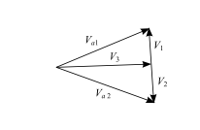
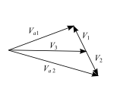
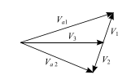
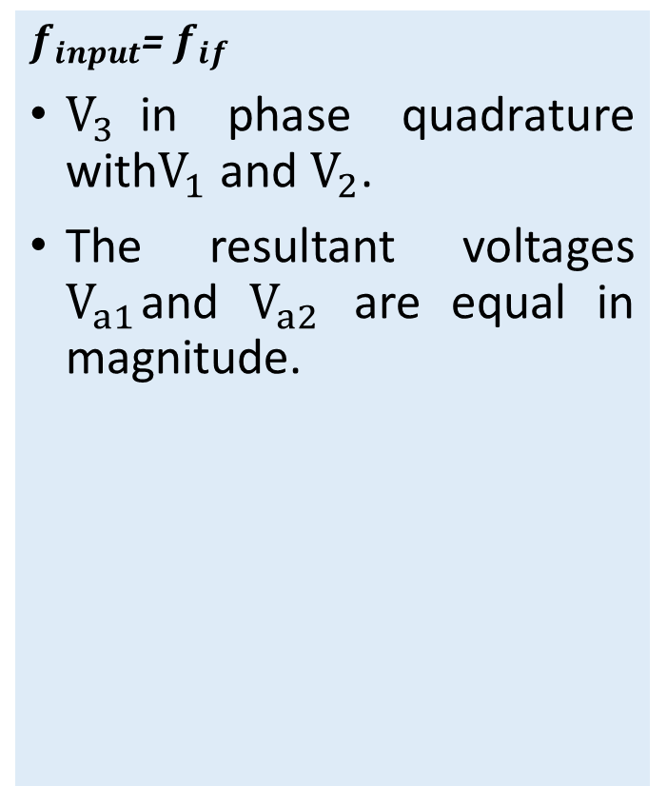
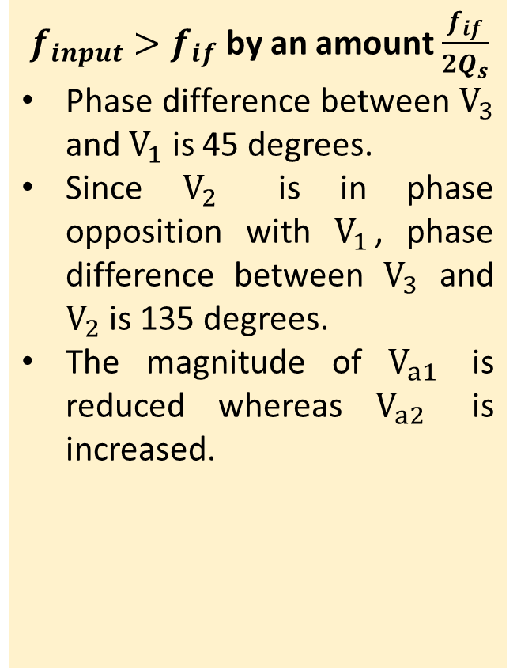
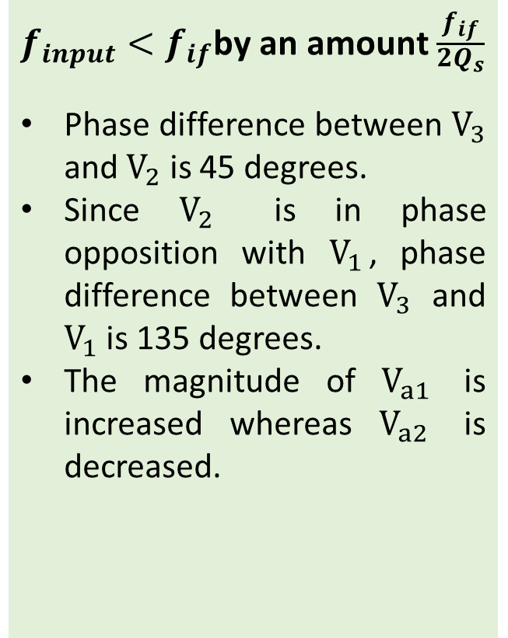
Foster-Seeley discriminator Contd..
Off resonance
At resonance
$f_{input}$= $f_{if}$
$V_{3}$in phase quadrature with$V_{1}$ and $V_{2}$.
The resultant voltages $V_{a1}$and $V_{a2}$ are equal in magnitude.
$f_{input}>f_{if}$ by an amount $\frac{f_{if}}{2Q_{s}}$
Phase difference between $V_{3}$ and $V_{1}$ is 45 degrees.
Since $V_{2}$ is in phase opposition with $V_{1}$, phase difference between $V_{3}$ and $V_{2}$ is 135 degrees.
The magnitude of $V_{a1}$ is reduced whereas $V_{a2}$ is increased.
$f_{input}<f_{if}$by an amount $\frac{f_{if}}{\begin{aligned}2Q_{s} \\ \end{aligned}}$
Phase difference between $V_{3}$ and $V_{2}$ is 45 degrees.
Since $V_{2}$ is in phase opposition with $V_{1}$, phase difference between $V_{3}$ and $V_{1}$ is 135 degrees.
The magnitude of $V_{a1}$ is increased whereas $V_{a2}$ is decreased.

Slide 23
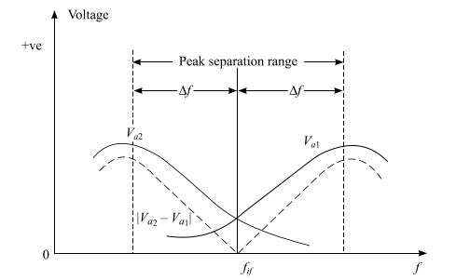
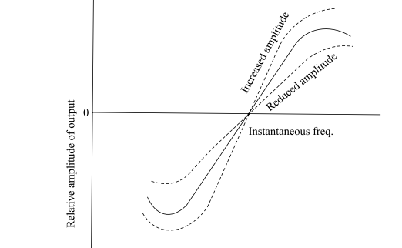
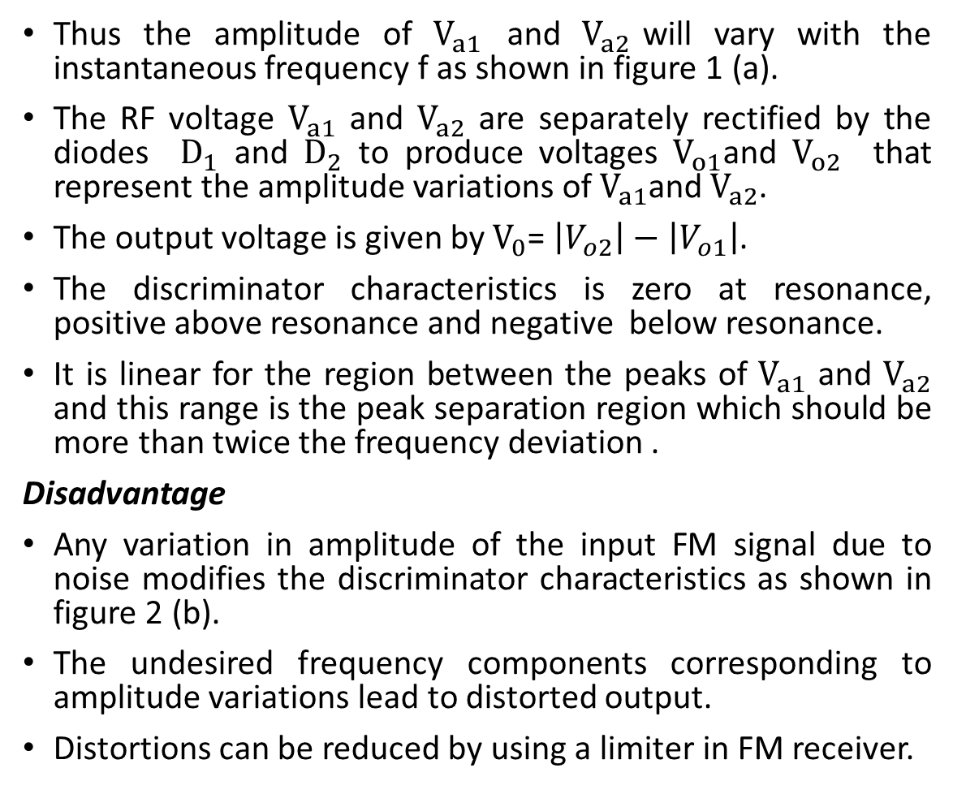
Foster-Seeley discriminator Contd..
Thus the amplitude of $V_{a1}$ and $V_{a2}$will vary with the instantaneous frequency f as shown in figure 1 (a).
The RF voltage $V_{a1}$ and $V_{a2}$ are separately rectified by the diodes $D_{1}$ and $D_{2}$ to produce voltages $V_{o1}$and $V_{o2}$ that represent the amplitude variations of $V_{a1}$and $V_{a2}$.
The output voltage is given by $V_{0}$= $\left|V_{o2}\right|−\left|V_{o1}\right|$.
The discriminator characteristics is zero at resonance, positive above resonance and negative below resonance.
It is linear for the region between the peaks of $V_{a1}$ and $V_{a2}$ and this range is the peak separation region which should be more than twice the frequency deviation .
Disadvantage
Any variation in amplitude of the input FM signal due to noise modifies the discriminator characteristics as shown in figure 2 (b).
The undesired frequency components corresponding to amplitude variations lead to distorted output.
Distortions can be reduced by using a limiter in FM receiver.
Figure 1 (a): Discriminator Characteristics
Figure 1 (b): Discriminator Characteristics

Slide 24
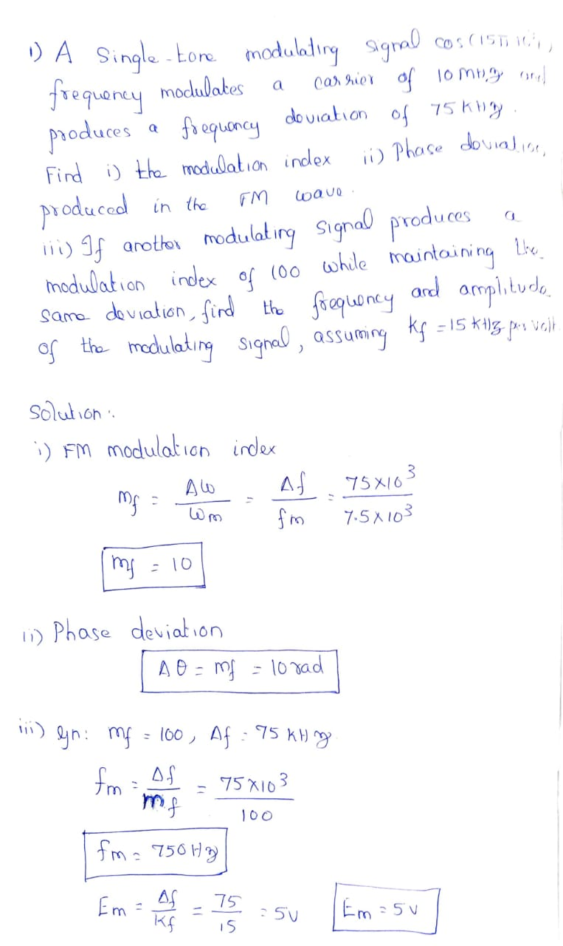

Slide 25
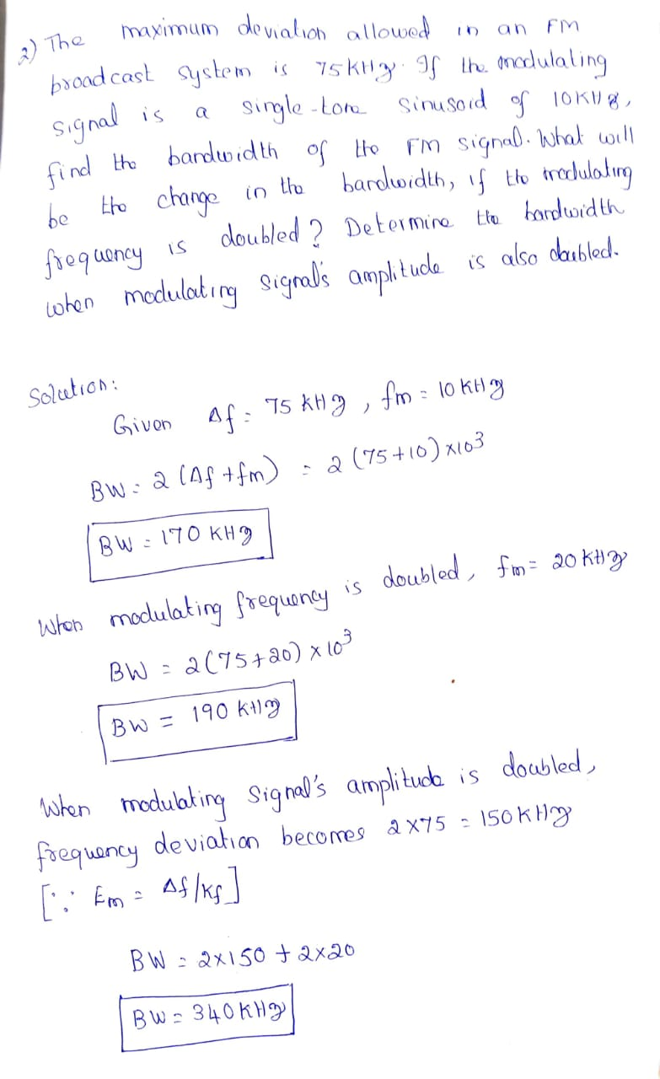

Slide 26
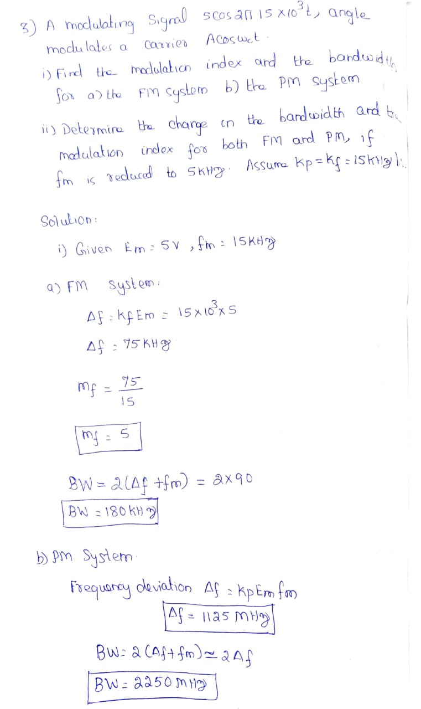

Slide 27
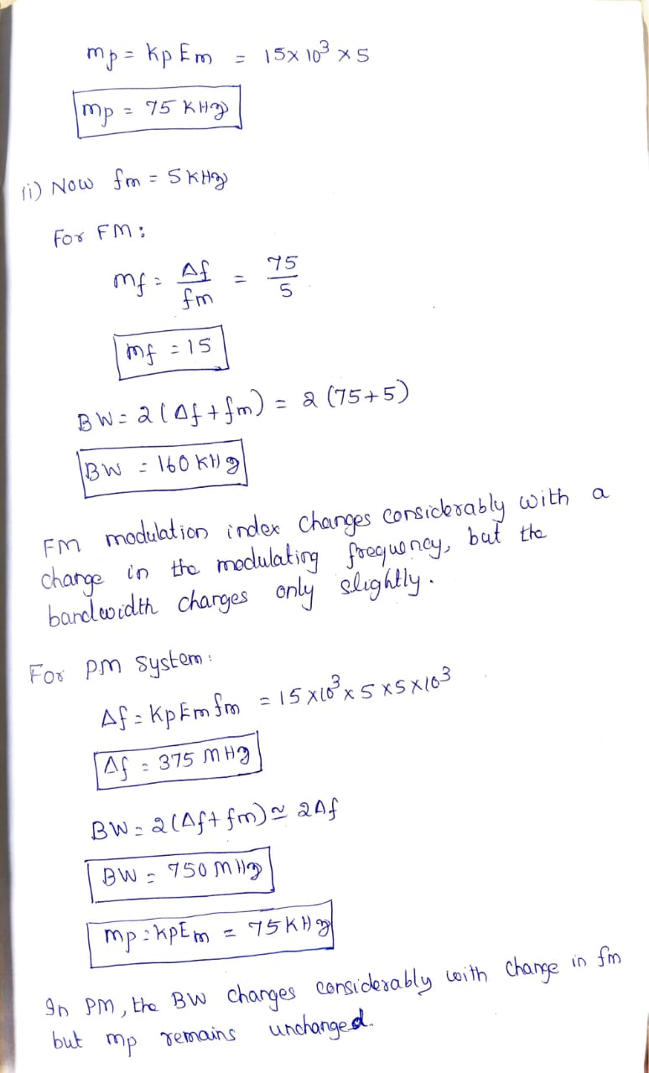

Slide 28
